Slide 1

Intelligent Inventory Management System
“An Intelligent Inventory Management System (IIMS) is a software application that helps companies track, analyze, and manage stock in a smart and automated way.”
“Intelligent Inventory Management System is an automated software that tracks stock levels, predicts demand, avoids shortages, and helps organizations maintain the right amount of inventory at the right time.”

Slide 2
Meaning of the Title/Project
Intelligent Inventory Management System:
Intelligent: Implies the system uses data analysis, automation, and potentially machine learning to make informed decisions.
Inventory: Refers to the stock of goods or materials held by a business.
Management: Encompasses the processes of planning, organizing, and controlling inventory levels.
System: A set of interconnected components working together to achieve a common goal.
AIM : This project aims to create a system that intelligently manages inventory, optimizing stock levels, reducing waste, and improving overall efficiency through automation and data-driven insights.

Slide 3
Uses of the System
Optimized Stock Levels: Prevents overstocking and stockouts, minimizing holding costs and lost sales.
Automated Ordering: Automatically generates purchase orders when stock levels fall below predefined thresholds.
Real-time Visibility: Provides a clear, up-to-date view of inventory levels across all locations.
Demand Forecasting: Predicts future demand based on historical data, seasonality, and other factors.
Reduced Waste: Minimizes spoilage, obsolescence, and other forms of inventory loss.
Improved Efficiency: Streamlines inventory management processes, freeing up staff time for other tasks
Reduces Human Errors : human errors
Example : medical shop /pharma industry

Slide 4
Problems of Existing system
Manual Data Entry → High Human Errors
Traditional systems depend on pen-paper or Excel sheets. Common errors:
Wrong quantity entered
Items not updated after sale
Mistyped product codes
No Real-Time Stock Tracking
Managers do not know:
Current stock
Items that are almost finished
Fast-moving or slow-moving products
This leads to:
Out-of-stock situations
No Automated Alerts
Manual systems do not give:
Low-stock alerts
Expiry alerts
Purchase reminders
Managers must check everything manually
Poor Inventory Visibility Across Locations
If a business has multiple branches:
No centralized system
One branch doesn’t know stock of another
This causes delays and confusion

Slide 5
Problems in Existing System
Manual errors
No real-time updates
No forecasting
Late reordering
Stockouts & overstock
High wastage
No expiry tracking
Time-consuming
Poor data security
No alerts
Proposed System:
Automated Inventory Tracking: Real-time monitoring of stock levels Automated Ordering: Automatically generates purchase orders when stock levels fall below predefined thresholds.
Alerts and Notifications: Sends alerts when stock levels are low, products are expiring, or other critical events occur.
Comprehensive Reporting: Provides detailed reports on inventory levels, sales trends, and other key metrics.

Slide 6
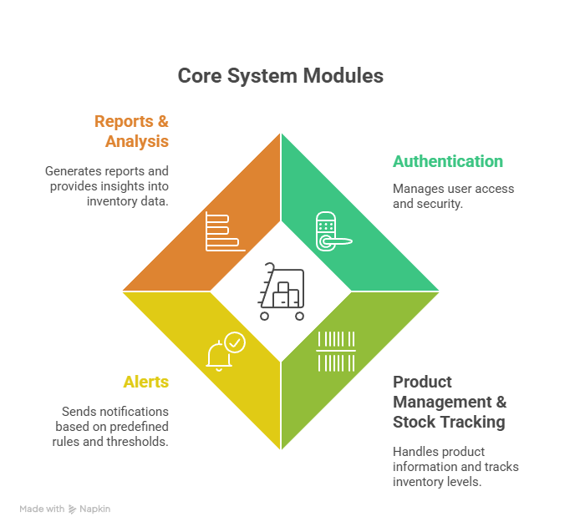
System Modules
The Intelligent Inventory Management System consists of four key modules:
Authentication: Manages user access and security.
Product Management & Stock Tracking: Handles product information and tracks inventory levels.
Alerts: Sends notifications based on predefined rules and thresholds.
Reports & Analysis: Generates reports and provides insights into inventory data.

Slide 7
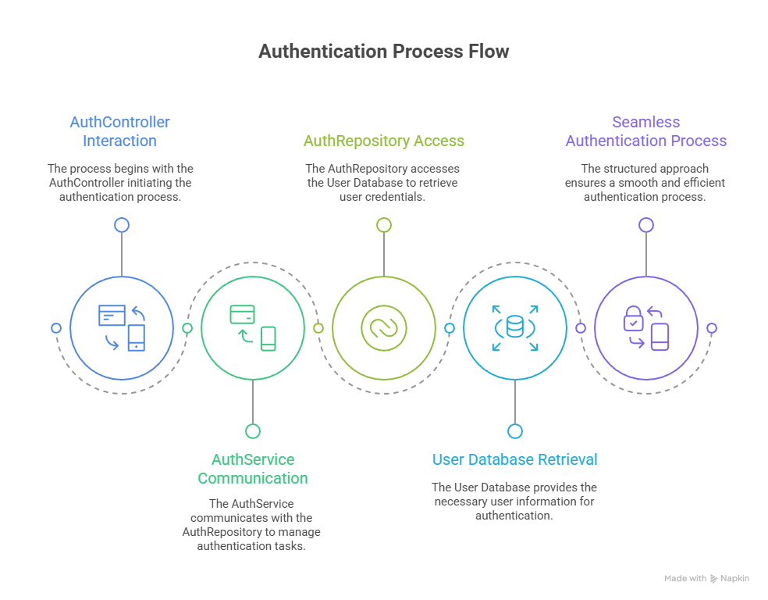
Module Working Processes
Module 1:

Slide 8
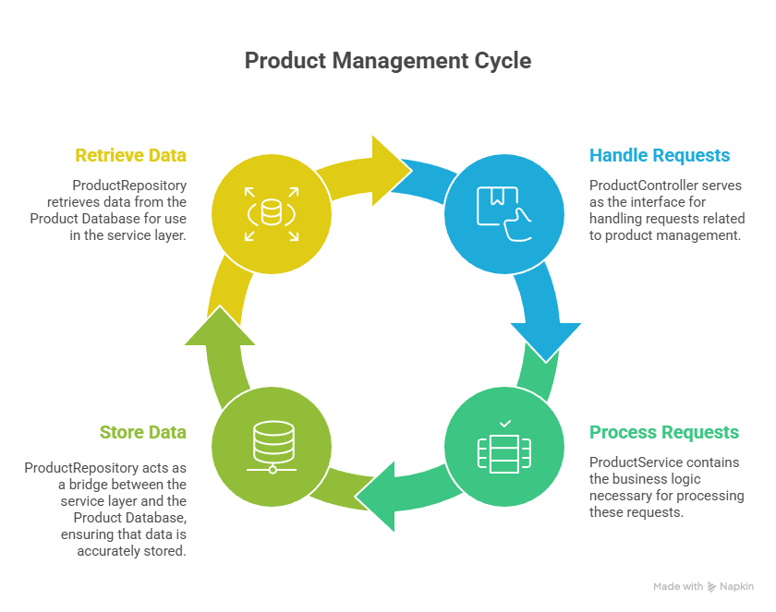
Module 2:

Slide 9
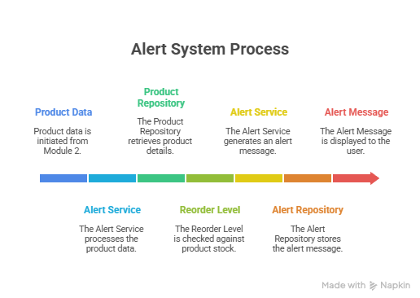
Module 3:

Slide 10
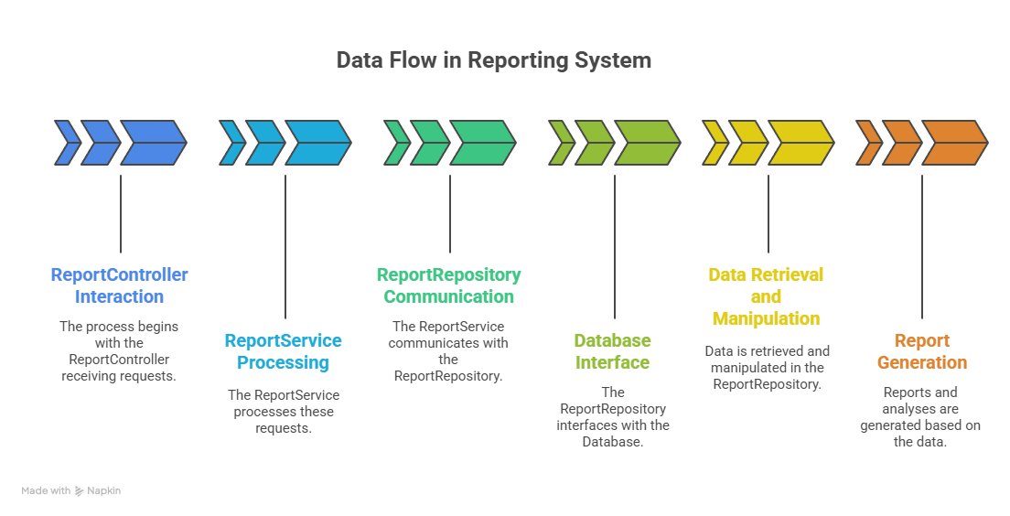
Module 4:
Reports & Analysis

Slide 11
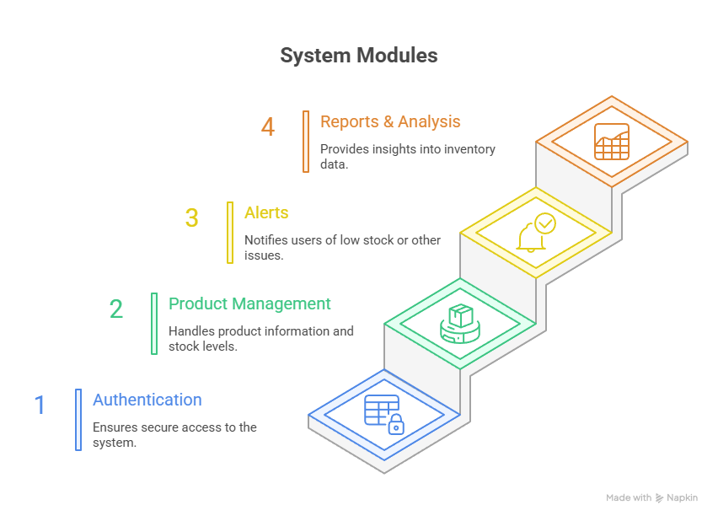

Slide 12
System Configuration
Frontend:
Technology: html, css, js, bootstrap
Purpose: User interface for interacting with the system.
Features: User authentication, product management, stock tracking, report viewing, and alert management.
Backend:
Technology: Java (Spring Boot)
Database: MySQL
Purpose: Handles data storage, business logic, and API endpoints.
API: RESTful API for communication between the frontend and backend.
Tools :
backend : intellij IDE ,postman,xampp
Frontend : vs code

Slide 13
Module 1 - Authentication
Process:
User enters credentials (username/password).
AUTH Controller receives the request.
AUTH Controller calls AUTH Service to validate the credentials.
AUTH Service calls AUTH Repository to retrieve user data from the User Database.
AUTH Repository queries the User Database.
AUTH Service compares the entered credentials with the data from the database.
If valid, AUTH Service generates a token (e.g., JWT).
AUTH Controller returns the token to the user.
Classes:
AUTH Controller: Handles authentication-related HTTP requests.
AUTH Service: Implements the authentication logic.
AUTH Repository: Interacts with the User Database.
User: Represents a user in the system (database entity).
Uses:
Secure user access to the system.
Role-based access control (RBAC).
Protection of sensitive data.

Slide 14
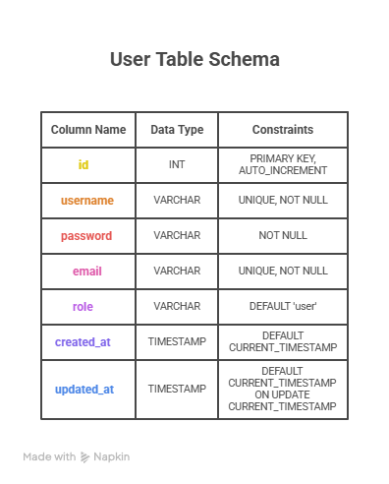

Slide 15
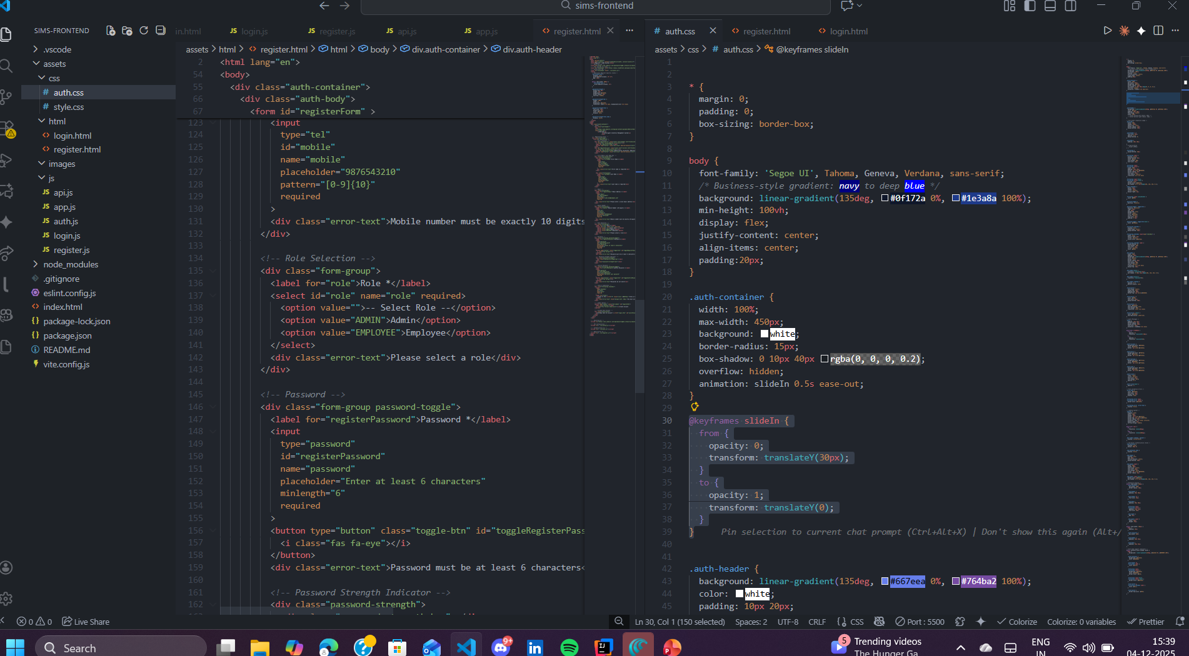
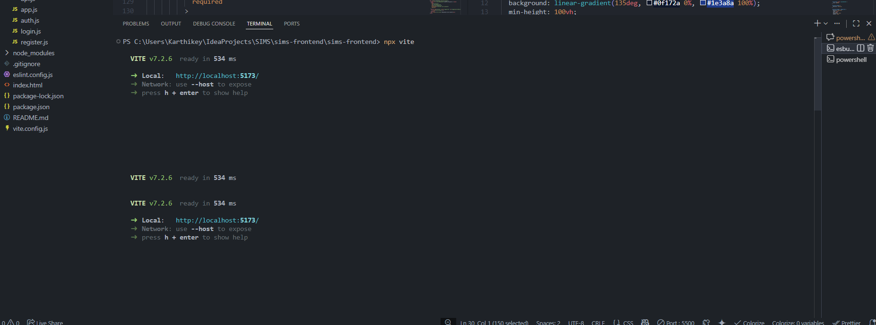

Slide 16
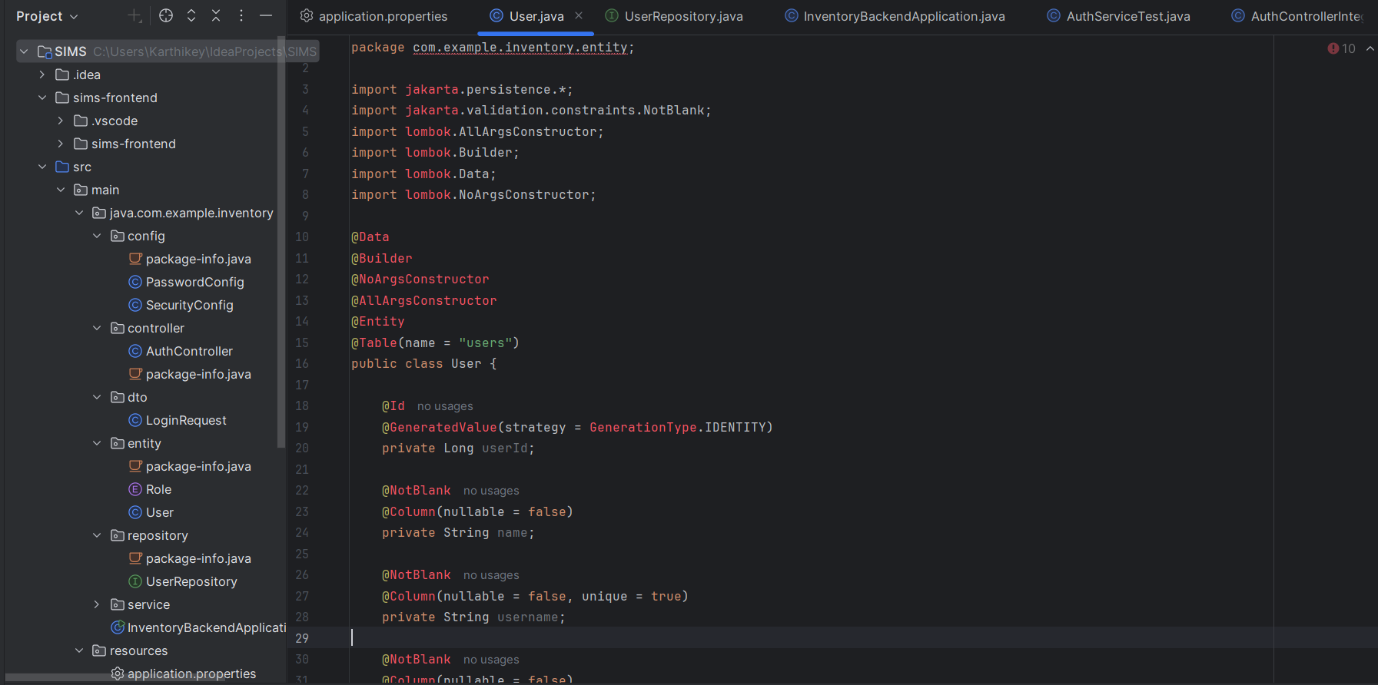
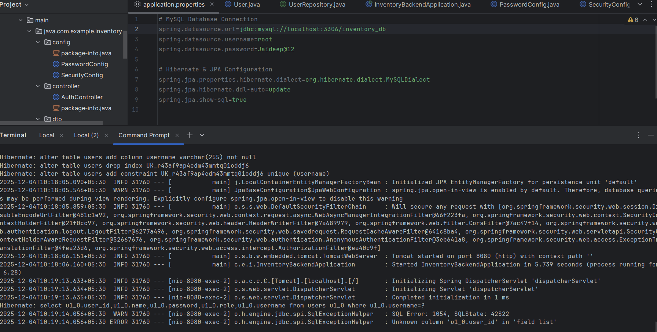
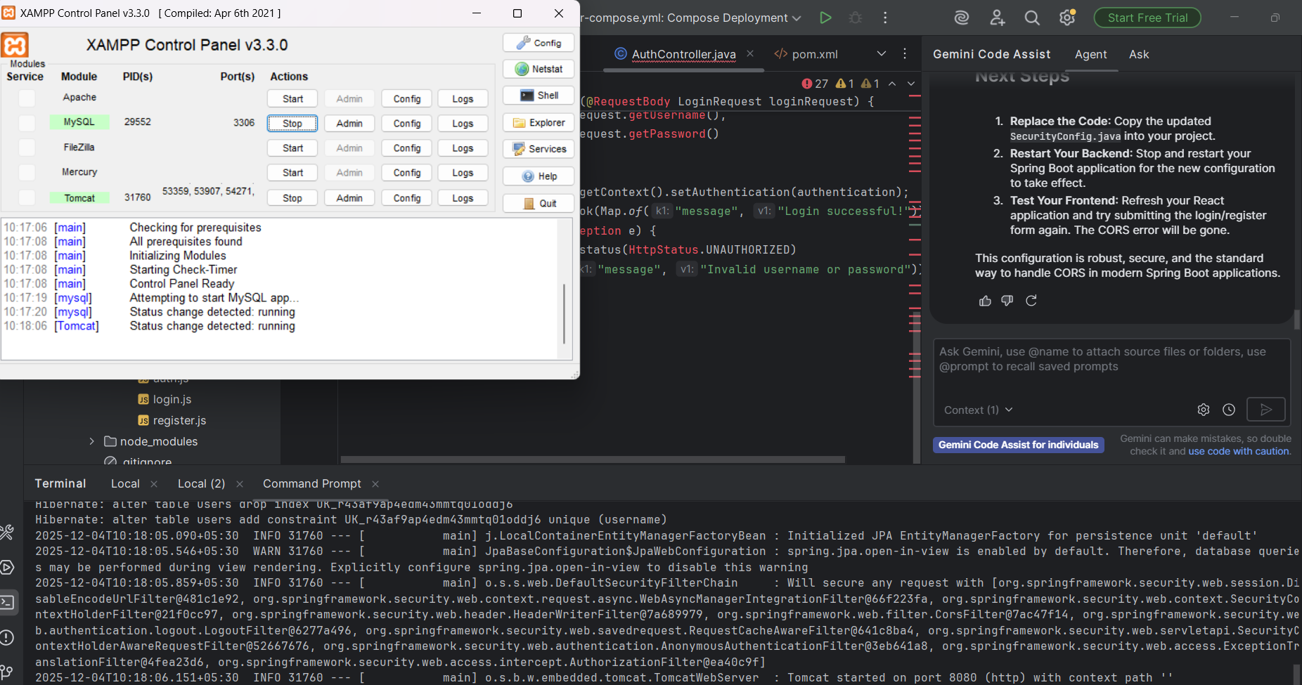

Slide 17
